Slide 1
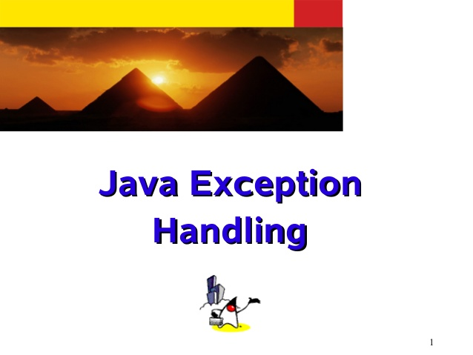
Exceptions

Slide 2
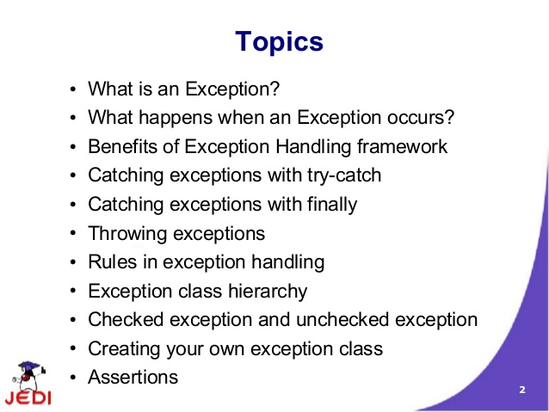
exceptions

Slide 3
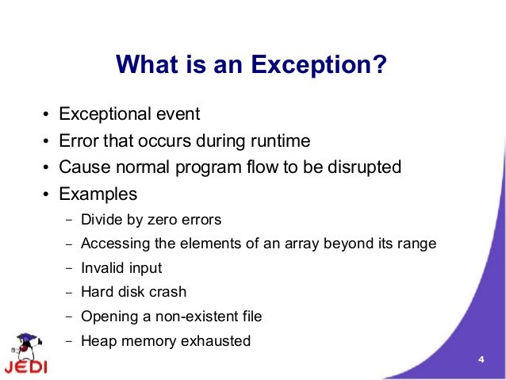
exceptions

Slide 4
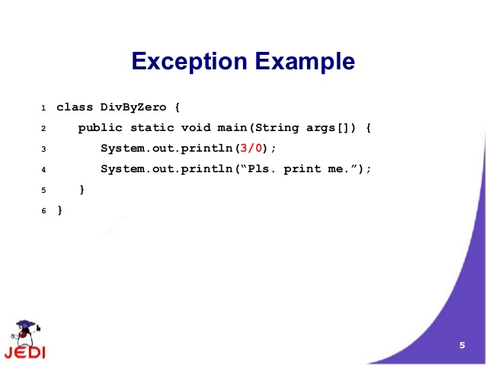
exceptions

Slide 5
exceptions

Slide 6
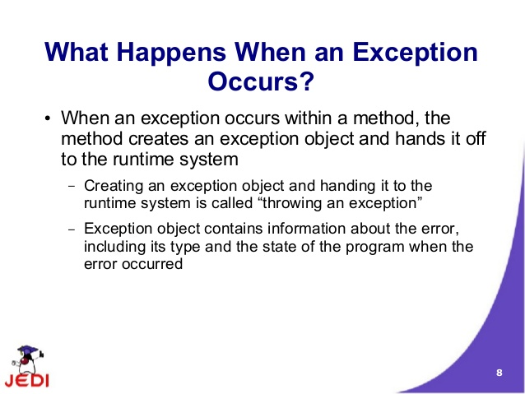
exceptions

Slide 7
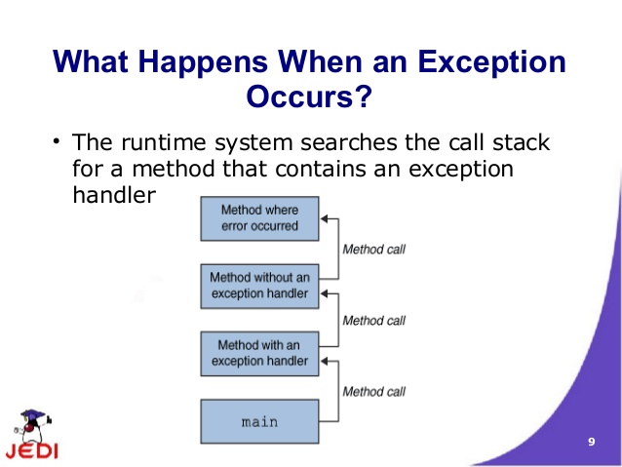
exceptions

Slide 8
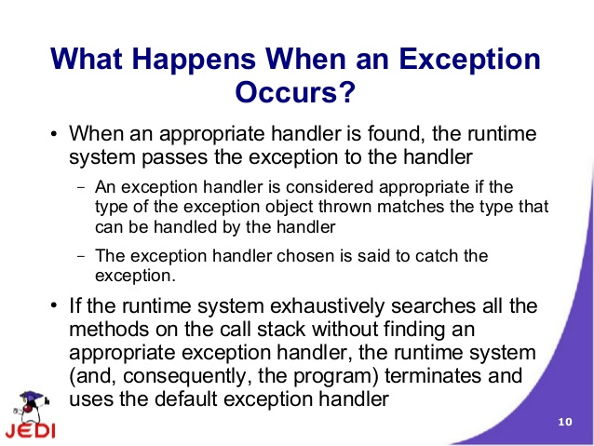
exceptions

Slide 9
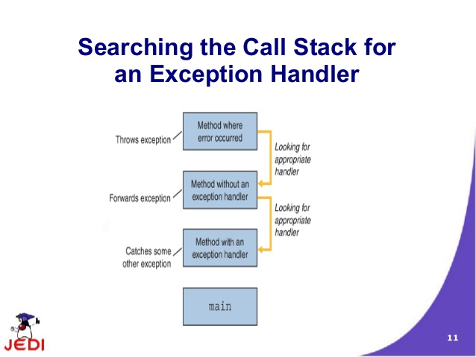
exceptions

Slide 10
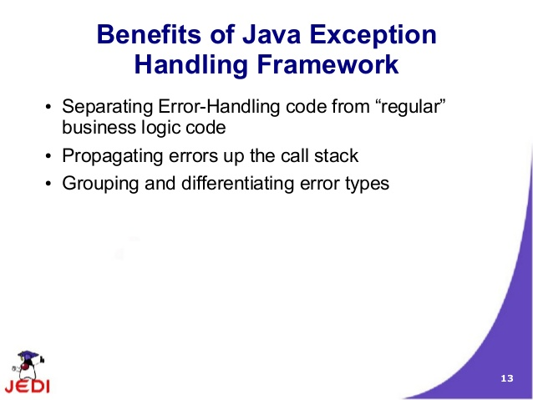
exceptions

Slide 11
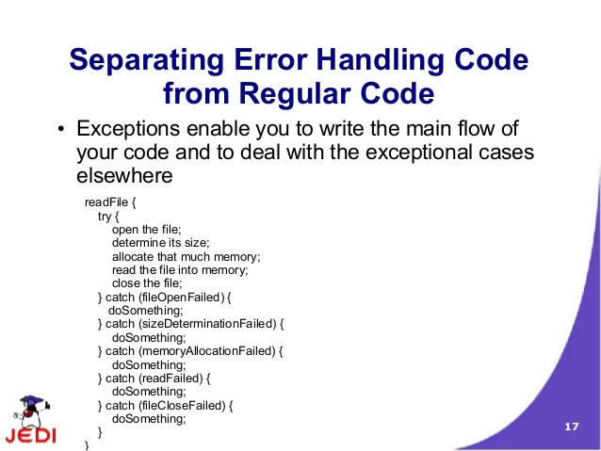
exceptions

Slide 12
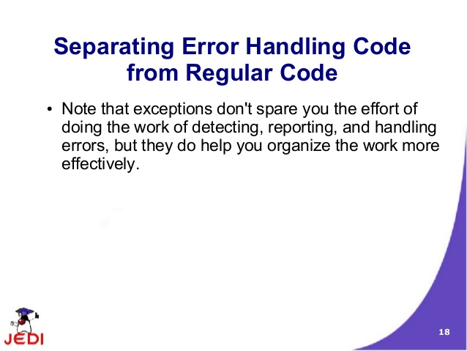
exceptions

Slide 13
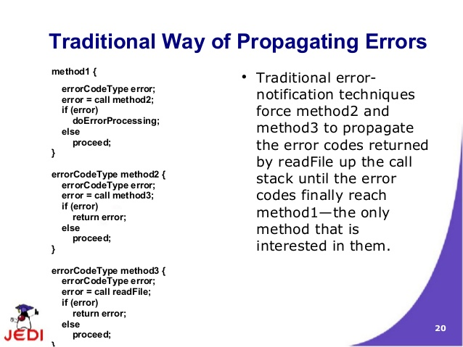
exceptions

Slide 14
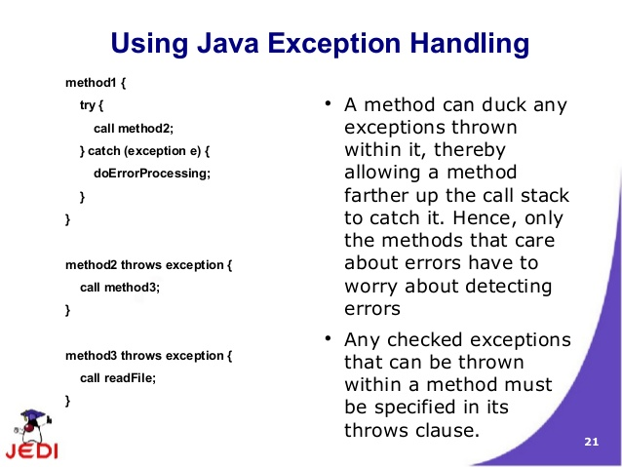
exceptions

Slide 15
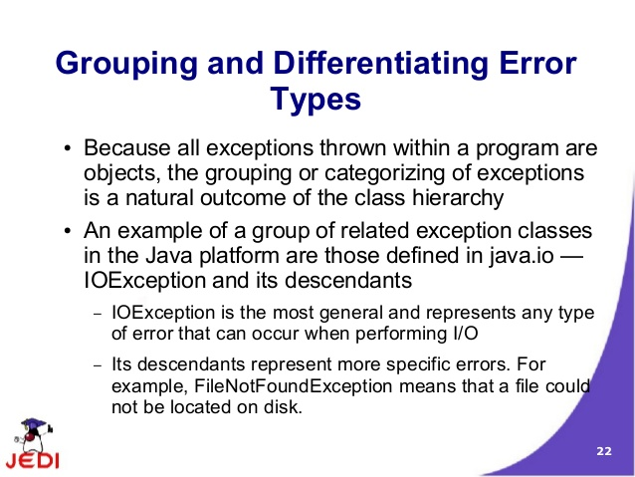
exceptions

Slide 16
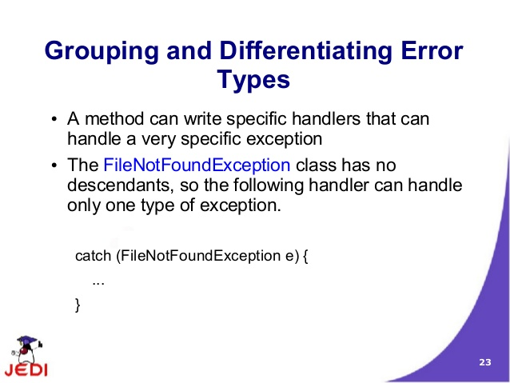
exceptions

Slide 17
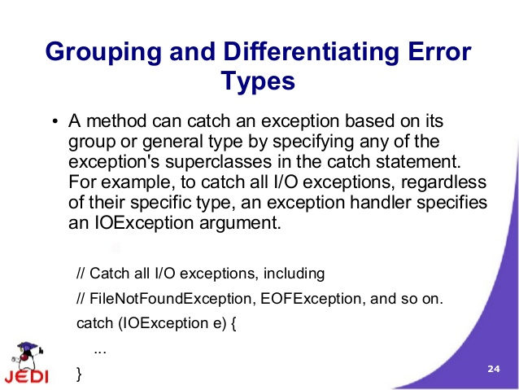
exceptions

Slide 18
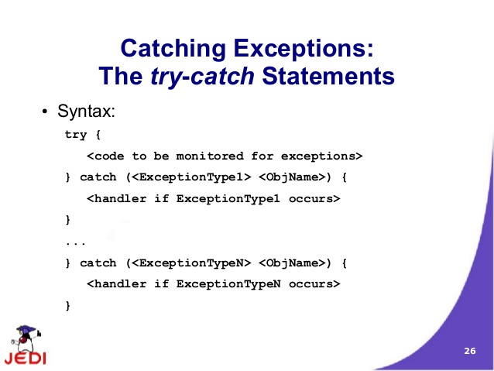
exceptions

Slide 19
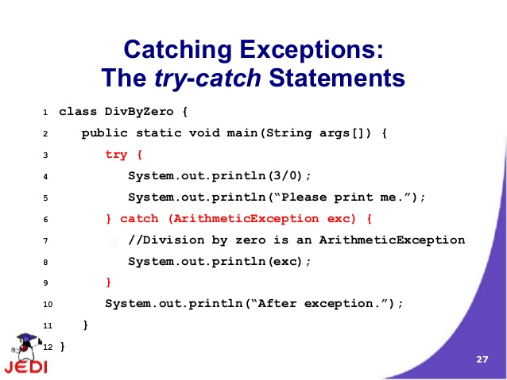
exception

Slide 20
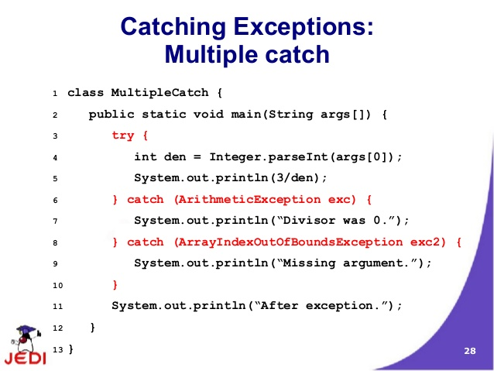
inheritance

Slide 21
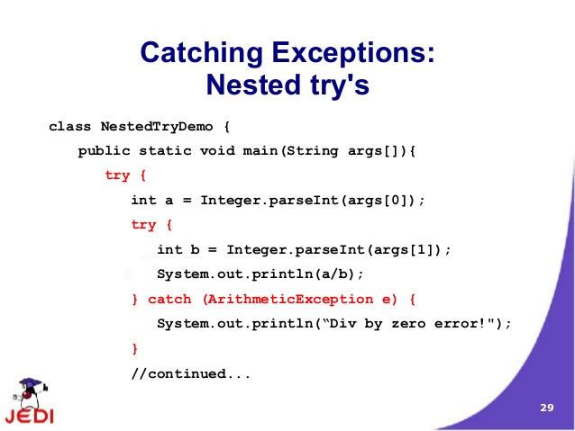
inheritance

Slide 22
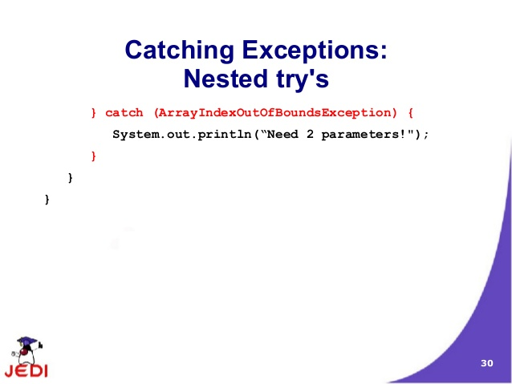
exceptions

Slide 23
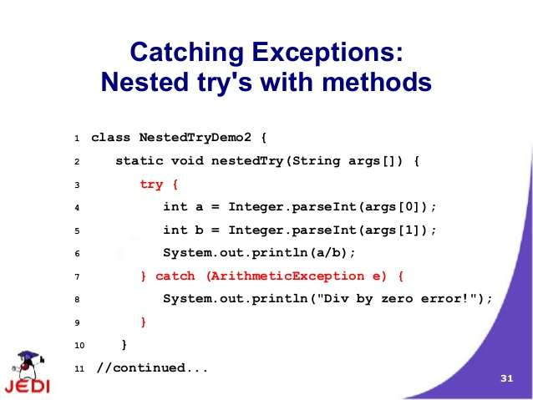
exceptions

Slide 24
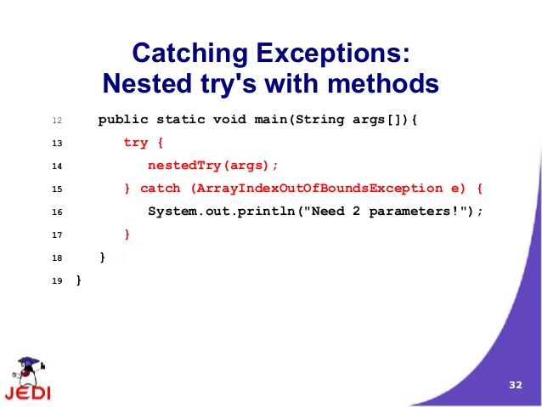
exceptions

Slide 25
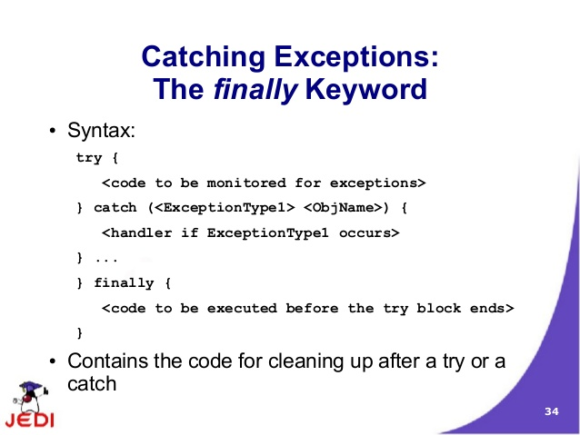
exceptions

Slide 26
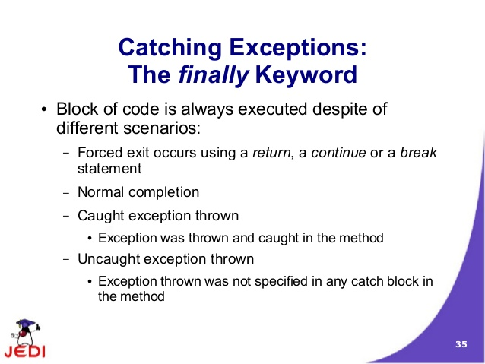
exceptions

Slide 27
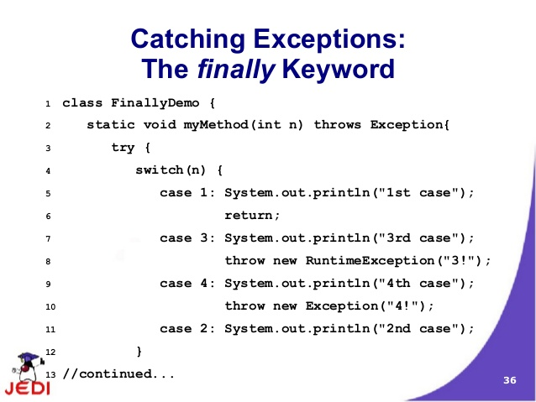
exceptions

Slide 28
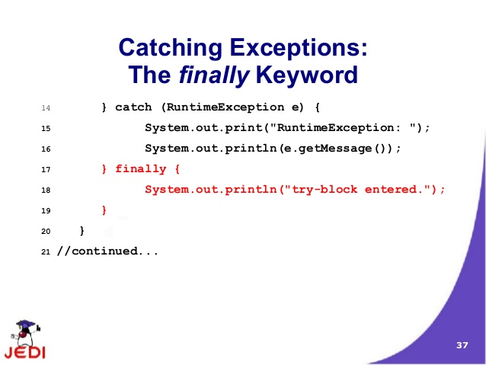
exceptions

Slide 29
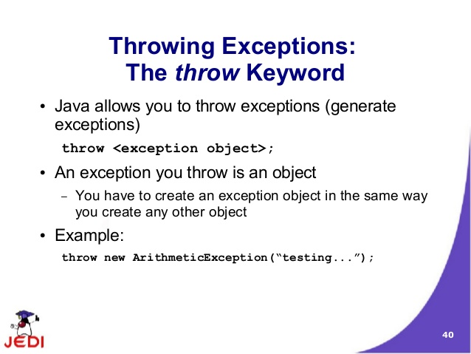
exceptions

Slide 30
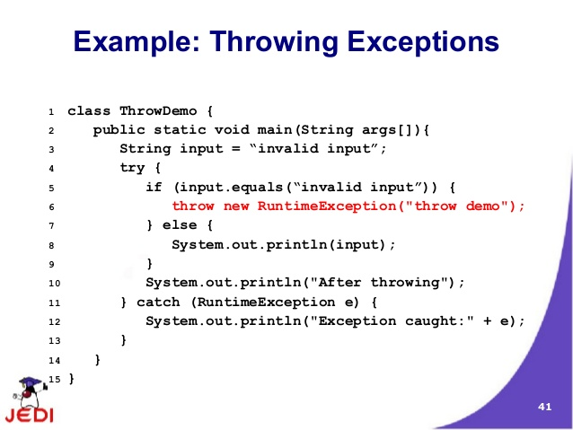
exceptions

Slide 31
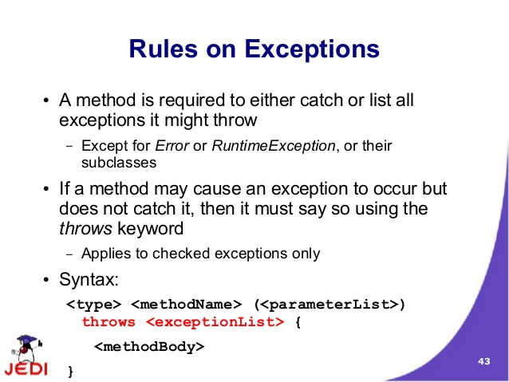
exceptions

Slide 32
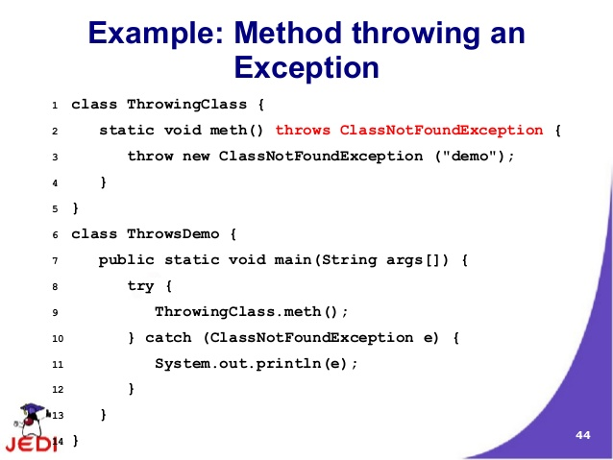
exceptions

Slide 33
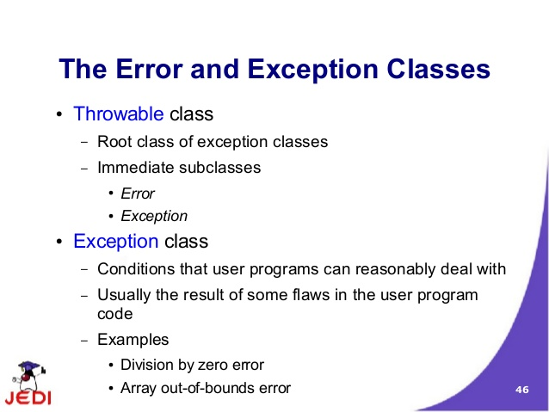
exceptions

Slide 34
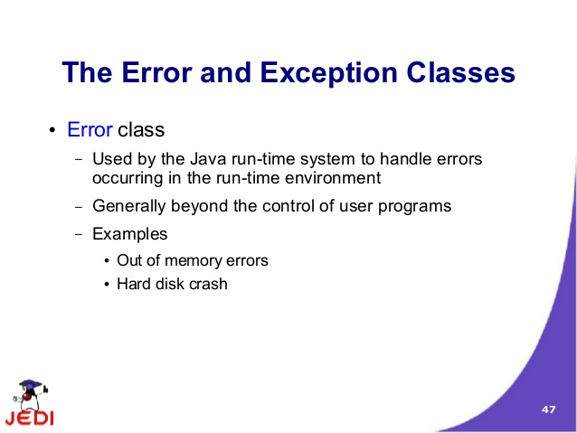
exceptions

Slide 35
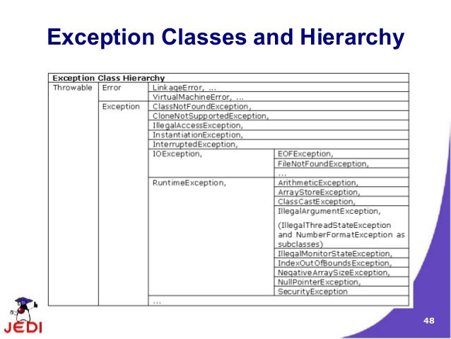
exceptions

Slide 36
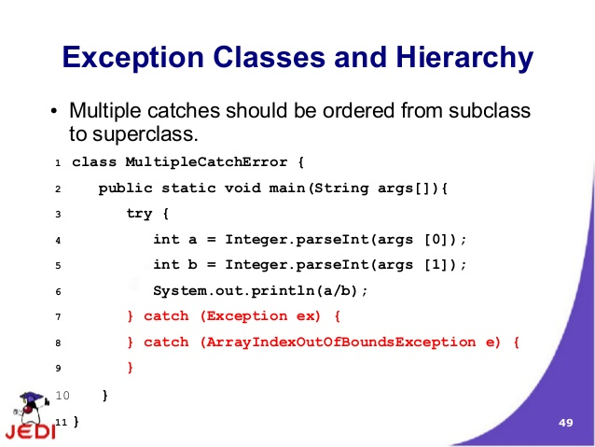
exceptions

Slide 37
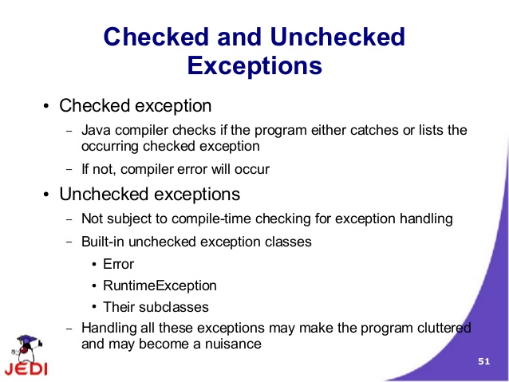
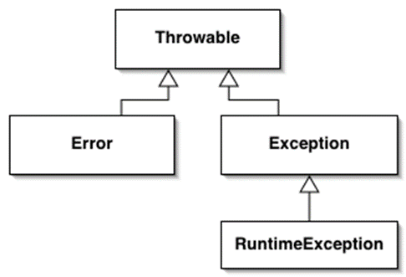
exceptions

Slide 38
exceptions
Checked Exceptions:
The application should anticipate and handle this exception.
Eg: java.io.FileNotFoundException.
All exceptions are checked exceptions, except for those indicated by Error, RuntimeException, and their subclasses
UnChecked Exceptions:
Error:
Exceptional conditions that are external to the application.
Eg: java.io.IOError.
Runtime Exception:
These are exceptional conditions that are internal to the application
application usually cannot anticipate or recover from
Eg: NullPointerException
.

Slide 39
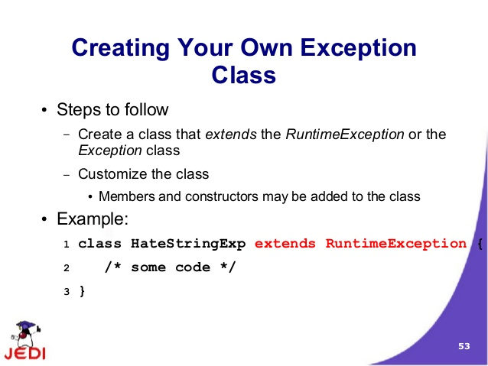
exceptions

Slide 40
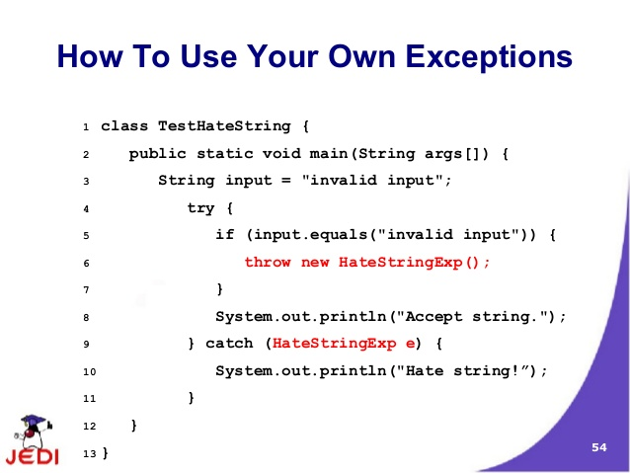
exceptions

Slide 41
exceptions

Slide 42
exceptions

Slide 43
exceptions

Slide 44
exceptions

Slide 45
inheritance

Slide 46
inheritance

Slide 47
inheritance

Slide 48
inheritance

Slide 49
inheritance

Slide 50
inheritance

Slide 51
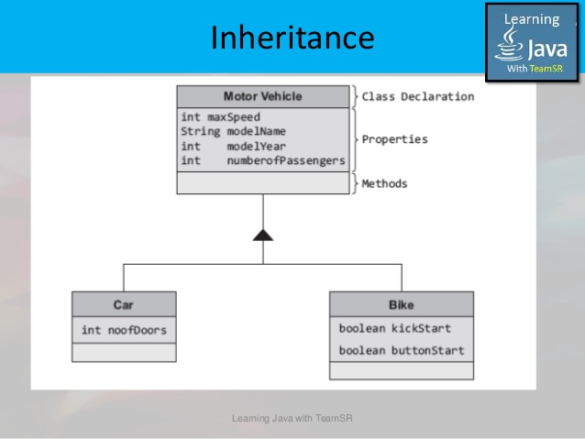

inheritance

Slide 52
Interfaces and inheritance

Slide 53
Java - miscellaneous
Type Comparison Operator instanceof
The instanceof operator compares an object to a specified type.
You can use it to test if an object is an instance of a class, an instance of a subclass, or an instance of a class that implements a particular interface
Classes implementing interfaces
class MyClass extends MySuperClass implements YourInterface {
// field, constructor, and
// method declarations
}

Slide 54
Java - miscellaneous
Varargs – Specifying Arbitrary number of arguments
public Polygon polygonFrom(Point... corners) {
int numberOfSides = corners.length;
double squareOfSide1, lengthOfSide1;
squareOfSide1 = (corners[1].x - corners[0].x)
* (corners[1].x - corners[0].x)
+ (corners[1].y - corners[0].y)
* (corners[1].y - corners[0].y);
lengthOfSide1 = Math.sqrt(squareOfSide1);
// more method body code follows that creates and returns a
// polygon connecting the Points
}
You will most commonly see varargs with the printing methods; for example, this printf method:
public PrintStream printf(String format, Object... args)
allows you to print an arbitrary number of objects. It can be called like this:
System.out.printf("%s: %d, %s%n", name, idnum, address);

Slide 55
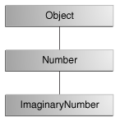
Java - miscellaneous
Returning a Class or Interface
When a method uses a class name as its return type the class of the type of the returned object must be either a subclass of, or the exact class of, the return type.
public Number returnANumber() {
...
}
The returnANumber method can return an ImaginaryNumber but not an Object. ImaginaryNumber is a Number because it's a subclass of Number. However, an Object is not necessarily a Number — it could be a String or another type

Slide 56
Advanced java
Garbage collection
JDBC
Lambda expressions
Annotations

Slide 57
references
https://docs.oracle.com/javase/tutorial/reallybigindex.html
http://www.slideshare.net/EdurekaIN/java-class-3
http://www.slideshare.net/abdurrehmanabdurrehman391/variables-and-data-types-by-sir-khalid
http://www.slideshare.net/abdurrehmanabdurrehman391/java-advancedoop
http://www.slideshare.net/MindfireSolutions/java-garbage-collection-how-it-works?next_slideshow=1
http://www.slideshare.net/arnold7490/unit-4-java
http://www.slideshare.net/arnold7490/unit-3-java?next_slideshow=1
http://www.slideshare.net/tushardesarda/java-tutorial-3
http://www.slideshare.net/muralidhar9e/java-exception-handling-ppt

